Slide 1


micro:bit programming tutorial
Lesson 10
micro:bit basic lesson 10 “Anti-collision alarm”
Yahboom micro:bit tutorial

Slide 2
micro:bit programming tutorial
Part1
Part 2
Part3
Part 4
Part 5
Learning goals
Preparation
Search for blocks
Combine blocks
Have a try
Yahboom micro:bit tutorial

Slide 3
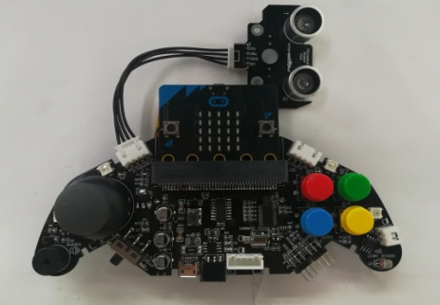
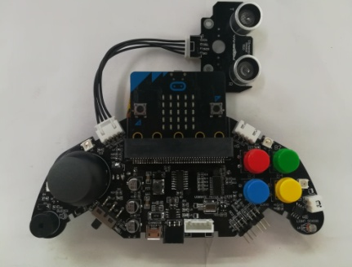
micro:bit programming tutorial
Part1
When the program is successfully downloaded, use the book to slowly approach the ultrasonic sensor from the front and then slowly move away. We can see that when the book is less than 3 cm away from the ultrasonic sensor, the light flashes and the buzzer continues to sound. When the distance is between three and eight centimeters, the buzzer emits a dripping sound, and the light flashes. When the distance is between 8 and 15, the sound of the buzzer is more moderate. If it is greater than 15, it will not alarm.
Yahboom micro:bit tutorial

Slide 4
micro:bit programming tutorial
Part2
Hardware：
● 1 X micro:bit Game Handle
● 1 X Micro USB Cable
Yahboom micro:bit tutorial

Slide 5
micro:bit programming tutorial
Two programming methods
Part2
1.Online: Connect Micro:bit to the computer via USB cable, and the computer will pop up a U disk and click the URL in the U disk to enter the programming interface.Enter this URL https://github.com/yahboomtechnology/ghbitlib to get the package named GHBit.
2.offline：Open micro:bit offline programming software and add GHBit package.Click on "Advanced" and select "Add Package".Enter this URL https://github.com/yahboomtechnology/ghbitlib to get the package named GHBit.
Note: If you already have a GHBit package, you don't need to add it repeatedly.
Yahboom micro:bit tutorial

Slide 6
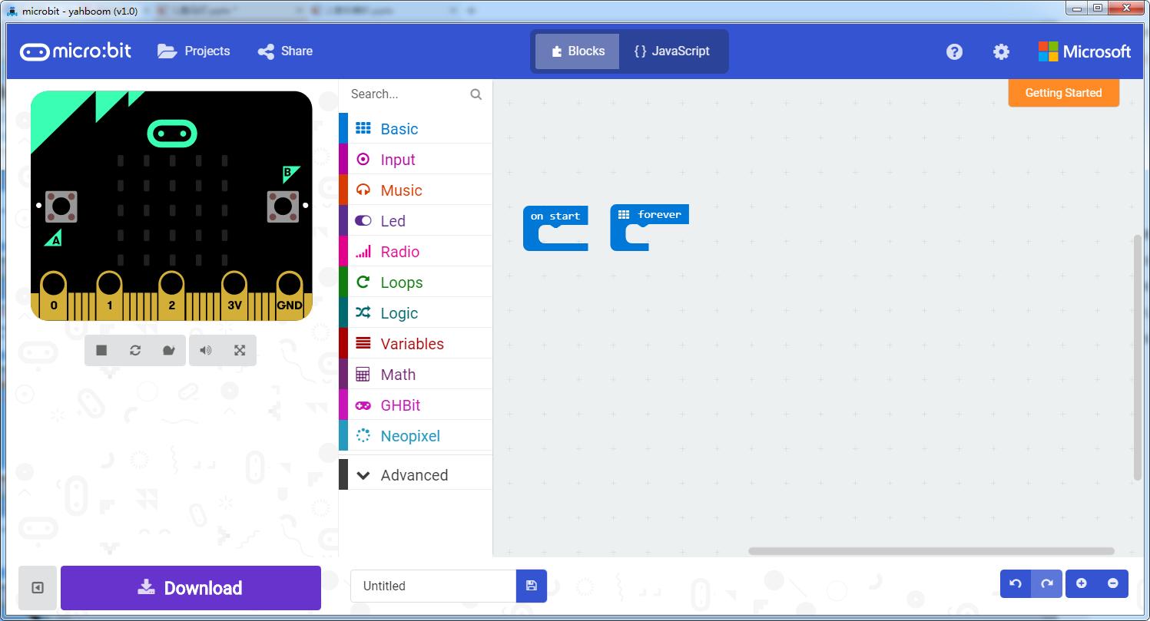
micro:bit programming tutorial
Programming interface
Part3
Yahboom micro:bit tutorial

Slide 7
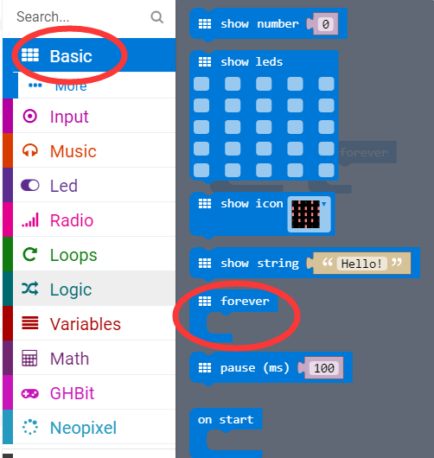
micro:bit programming tutorial
Part3
Start programming
The “forever” building block means that when the micro:bi Game Handle is turned on, the blocks in “forever” are repeatedly executed.
Yahboom micro:bit tutorial

Slide 8
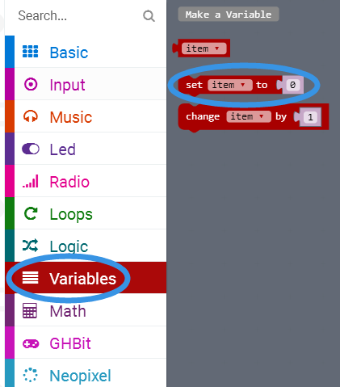
micro:bit programming tutorial
Part3
Sets this variable be equal to the input.
Yahboom micro:bit tutorial

Slide 9
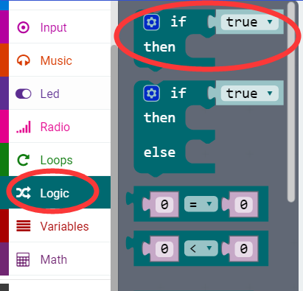
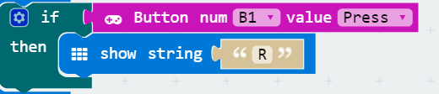
micro:bit programming tutorial
Part3
If a value is true, then do some statements.
For example: If the B1 button of the handle is pressed, the dot matrix display character R is executed. If the B1 button is not pressed, it will not be executed.
Yahboom micro:bit tutorial

Slide 10
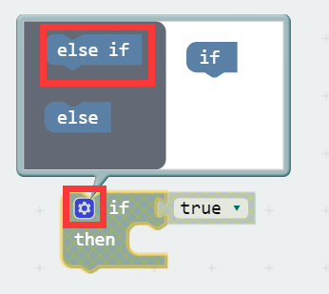
micro:bit programming tutorial
Part3
When there are many choices, you can click on the pinion above. Drag the "else if" on the left to the bottom of the "if" on the right, and click on the pinion again.
Yahboom micro:bit tutorial

Slide 11
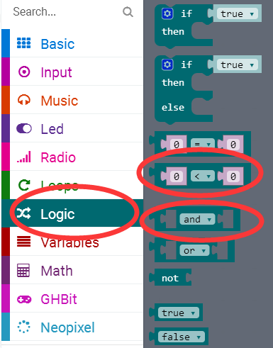

micro:bit programming tutorial
Part3
E.g：
This building block indicates that the value of the variable "item" is greater than 3 and less than or equal to 8.
Yahboom micro:bit tutorial

Slide 12
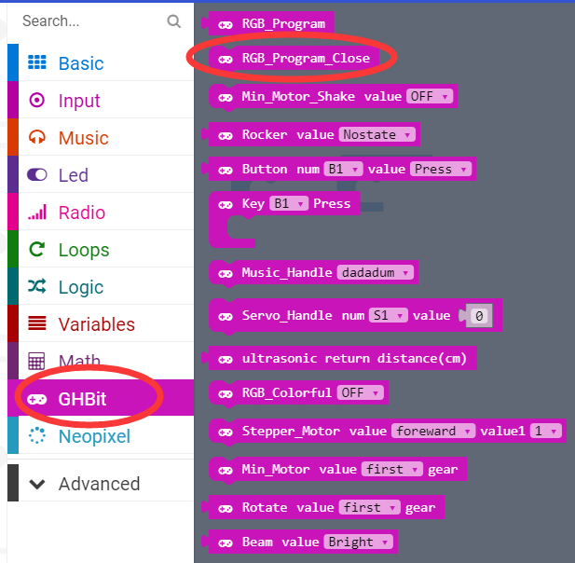
micro:bit programming tutorial
Part3
Turn off the colorful lights.
Note: Every time you complete an experiment on a colorful light, you need to use a program that turns off the colorful lights. Otherwise the colorful lights will remain on.
Yahboom micro:bit tutorial

Slide 13
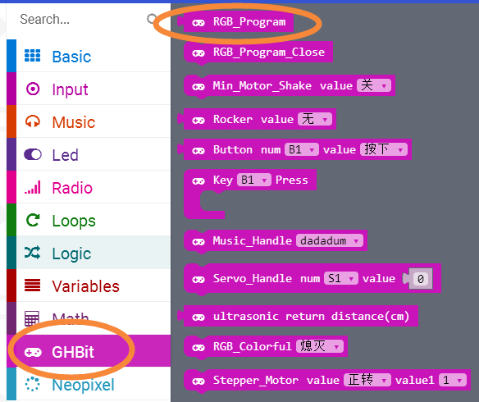
micro:bit programming tutorial
Part3
Use this building block when controlling the lights built into the micro:bit Game Handle.
Yahboom micro:bit tutorial

Slide 14
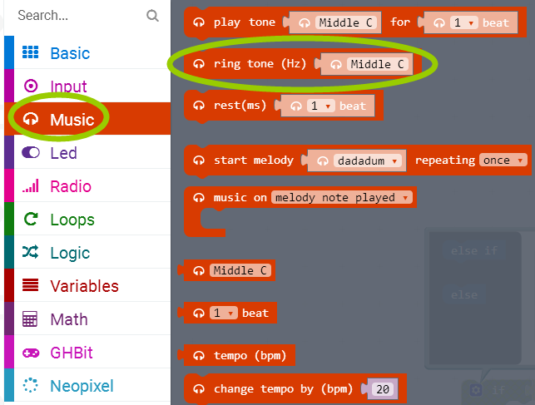
micro:bit programming tutorial
Part3
Plays tone through pin “P0”.In the handle, “P0” is connected to the buzzer, and the buzzer plays the ringtone.
Yahboom micro:bit tutorial

Slide 15
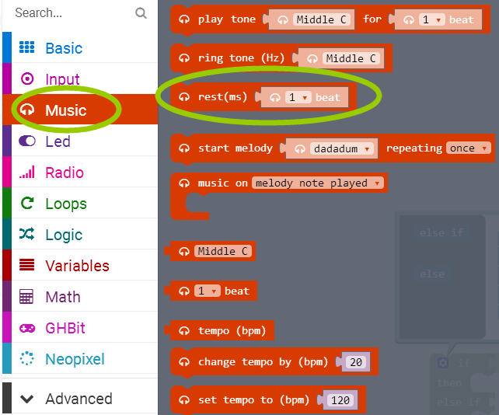
micro:bit programming tutorial
Part3
Rests(plays nothing)for a specified time through pin “P0”.
Yahboom micro:bit tutorial

Slide 16
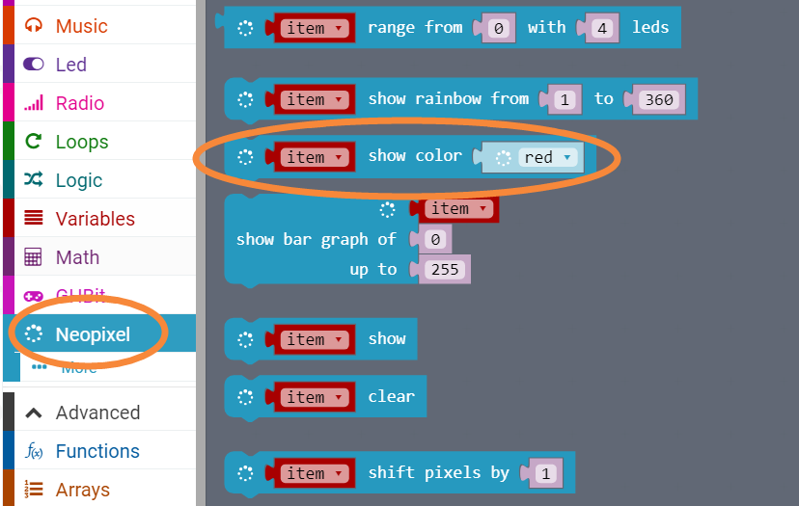
micro:bit programming tutorial
Part3
Select the color that the light on the handle is lit.
Yahboom micro:bit tutorial

Slide 17
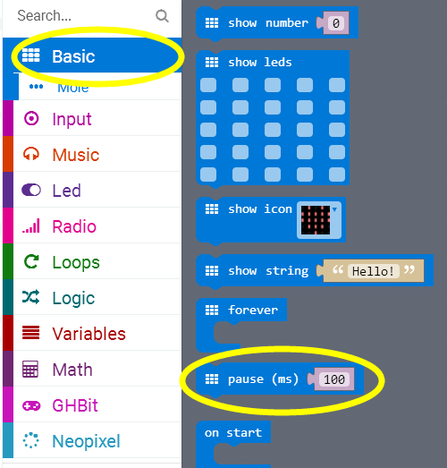
micro:bit programming tutorial
Part3
Pause for 100 milliseconds, in the program we change the value to 200 milliseconds.
Yahboom micro:bit tutorial

Slide 18
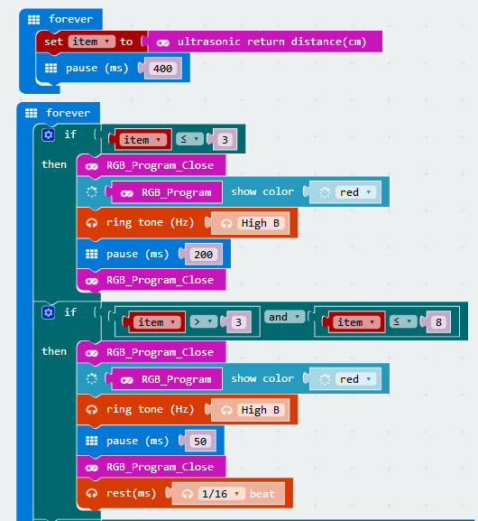
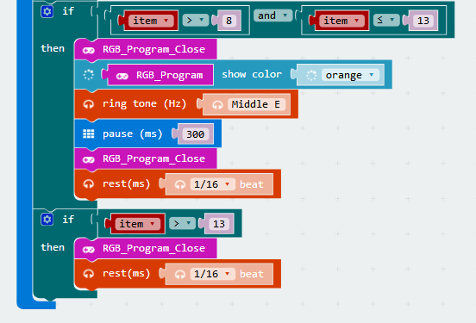
micro:bit programming tutorial
Part4
This is the complete building block for this course, let's download it to the micro:bit Game Handle.
Yahboom micro:bit tutorial

Slide 19
micro:bit programming tutorial
Part5
Do you learn the course today?
If you learn to do it, give yourself a top quack.
Now give you a homework assignment.
Modify the basis of this function, add a few alarm areas, the specific value is set by yourself.
Start your little brain. Try it.
Yahboom micro:bit tutorial

Slide 20
micro:bit programming tutorial
micro:bit
Thanks for watching！
Yahboom
Yahboom micro:bit tutorial

